Slide 1

POWER QUERY CASE STUDY
Duplicates. Blanks. No Structure.
Can Power Query Fix This?
A step-by-step transformation of a raw HR export into a clean, analysis-ready dataset - built entirely in Power Query.

Slide 2

THE BRIEF
One Flawed HR Export, Seven Fixes to Make
The HR team's source file tracks six fields per employee - Full Name, Email, Gender, Salary, Department and Hire Date. Before it can support any analysis, the raw export needs deliberate, structured cleanup.
1
Remove rows and columns irrelevant to analysis
5
Split Full Name into First and Last Name
2
Promote the first row to column headers
6
Sort the dataset by Hire Date, ascending
3
Remove duplicate and blank records
7
Insert an Employee ID column and move it to the front
4
Replace empty Email cells with “No Email”

Slide 3

STEP 01 · DIAGNOSE
Before Fixing Anything, the Data Was Audited
The source file was imported directly from a CSV export, with no header row promoted and no formatting applied. A column-by-column quality check surfaced exactly what needed attention.
Two fully empty columns
Column7 and Column8 carried 100% empty values - leftover artefacts with no analytical value.
Inconsistent completeness
Core fields ranged from 72% to 77% valid, with the rest split between blanks and duplicates.
No usable header row
Fields appeared as generic Column1-Column8 rather than named, typed attributes.

Slide 4
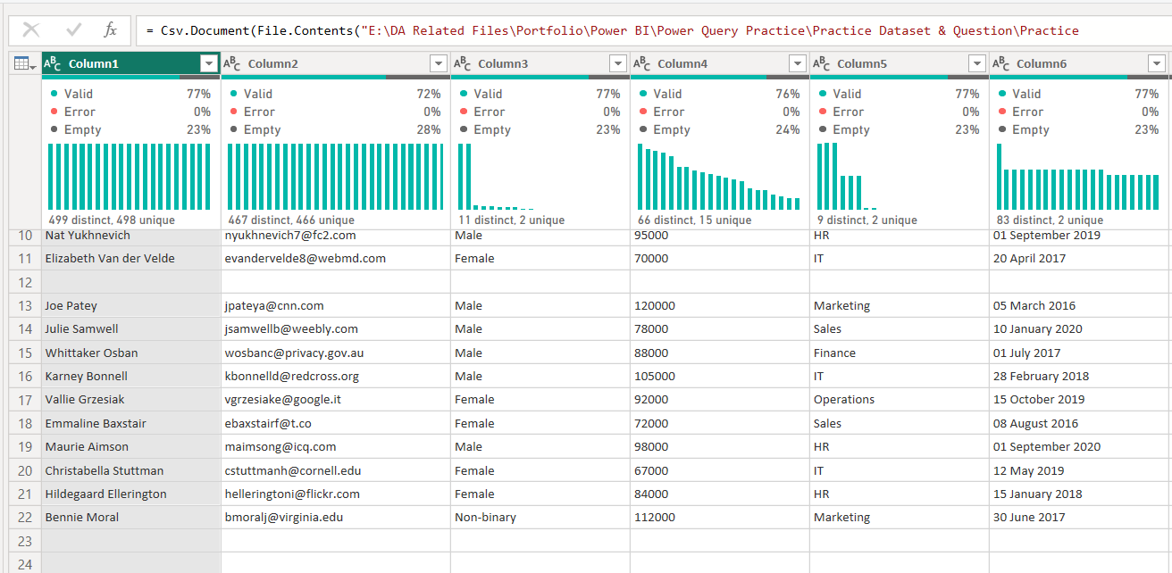
STEP 01 · DIAGNOSE
The Raw Import, Straight From Source
Csv.Document(File.Contents(...)) - unfiltered source connection inside Power Query.

Slide 5
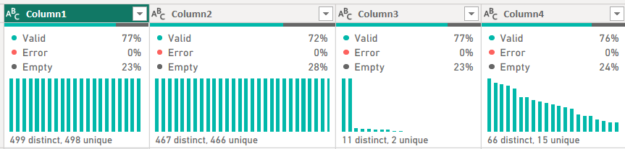
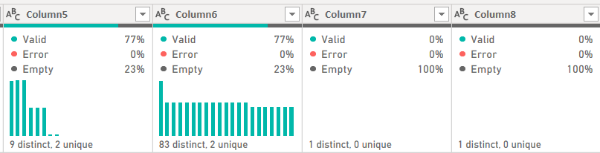
STEP 01 · DIAGNOSE
Column-Level Quality Check, Pre-Cleanup

Slide 6

STEP 02 · STRUCTURE
Clearing the Structural Noise
Removed the top row that held no usable data before the true header row
Promoted the first data row to serve as proper column headers
Removed Column7 and Column8 entirely - both were 100% empty
Removed blank rows so every remaining record carries real employee data
Removed duplicate entries to keep the dataset free of repeated records
2
empty columns removed
496
clean records retained

Slide 7



STEP 03 · STANDARDIZE
Giving Every Blank Cell a Clear Meaning
Blank cells are ambiguous - they don't tell you whether data is missing, unknown, or simply not collected. Two targeted Replace Values steps removed that ambiguity for the fields that needed it most.
Missing Email
Missing Salary
Blank → “No Email”
null → 0
Keeps every row analysis-ready without inventing an address.
Preserves numeric integrity so Salary stays aggregatable.

Slide 8
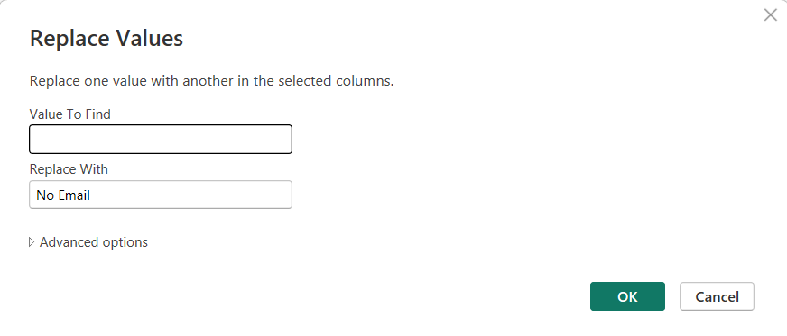
STEP 03 · STANDARDIZE
Replace Values - Email Column
Value to find left blank, Replace With set to “No Email” - applied to the Email column only.

Slide 9
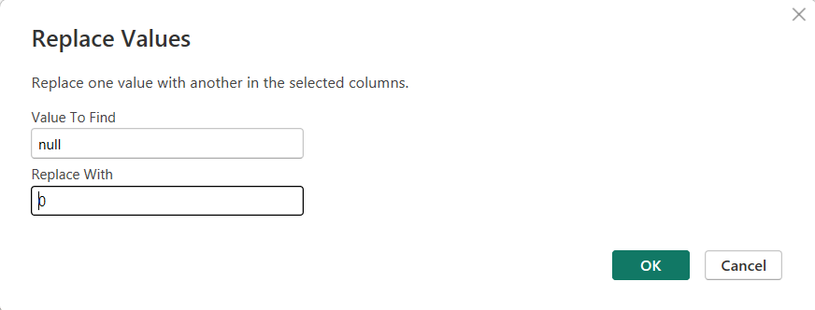
STEP 03 · STANDARDIZE
Replace Values - Salary Column
null values in Salary were replaced with 0, keeping the field numeric and chart-ready.

Slide 10

STEP 04 · RESTRUCTURE
One Name Field Isn't Enough for Analysis
A single Full Name column blocks first-name and last-name level reporting. Splitting it by delimiter unlocks that granularity - the level of detail a dataset can be broken down to.
Split by the Space delimiter, at the left-most occurrence
Produced two clean fields: Employee First Name and Employee Last Name
Both columns renamed and type-checked immediately after the split

Slide 11
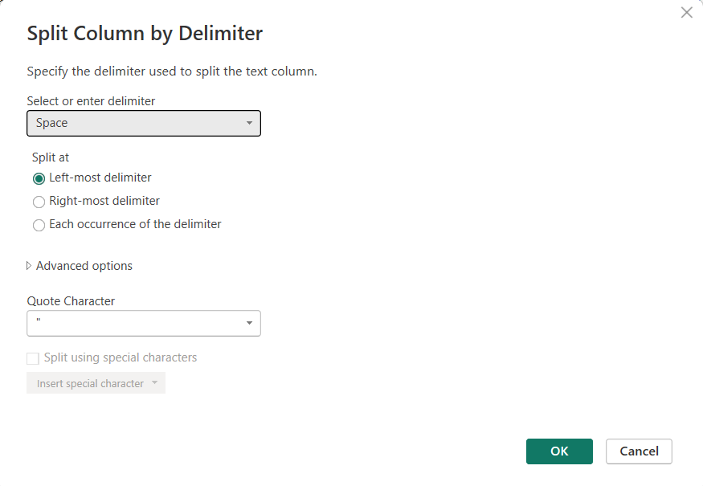
STEP 04 · RESTRUCTURE
Split Column by Delimiter - Full Name
Delimiter: Space · Split at: Left-most delimiter - separates first name from the remainder.

Slide 12

STEP 05 · ORDER
Putting Tenure in Order
With names, emails and salaries standardized, the dataset was sorted by Hire Date in ascending order - surfacing the longest-tenured employees first and giving any downstream timeline analysis a reliable starting point.
Sort by Hire Date
A → Z
Ascending, oldest hire date first
80 distinct hire dates spanning the full workforce

Slide 13

STEP 06 · ENRICH
Engineering a Unique Employee ID
The dataset had no unique identifier, so one was built in two stages: a sequential index, then a formatted ID derived from it.
1
Add Index Column
2
Add Custom Column
Starting index 1, increment 1 - one sequential number per row.
= "EM" & Text.PadStart(Text.From([Index]), 2, "0") - builds an EM-prefixed, zero-padded ID.

Slide 14
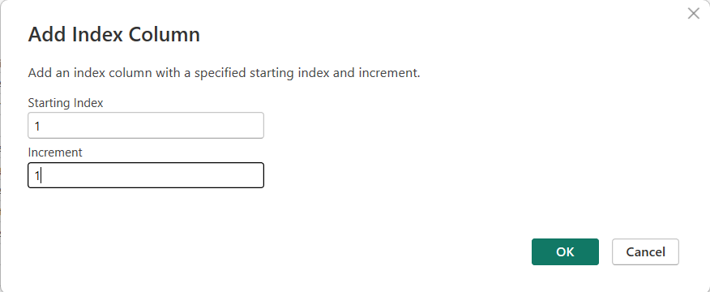
STEP 06 · ENRICH
Add Index Column
Starting Index: 1 · Increment: 1 - the foundation for the Employee ID formula.

Slide 15
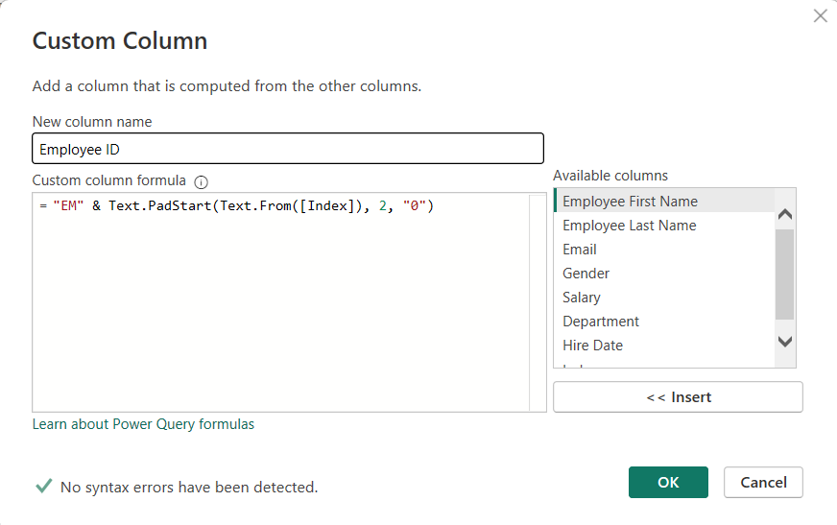
STEP 06 · ENRICH
Custom Column - Employee ID Formula
“EM” + zero-padded index → consistent, sortable IDs such as EM01, EM02 ...

Slide 16

STEP 07 · FINALIZE
Closing Out the Transformation
Converted Employee ID to the correct data type immediately after creation
Moved Employee ID to the very first position in the dataset
Confirmed Salary's column type after all replacements were applied
Removed the helper Index column - its job was done once the ID existed

Slide 17
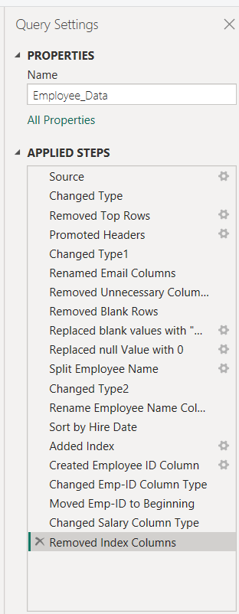
THE COMPLETE PIPELINE
Every Applied Step, in Order
Import & Structure
Source, type detection, header promotion, column removal
Cleaning
Blank row removal, Email and Salary replacements
Transformation
Name split, type fixes, sort by Hire Date
Enrichment
Index, Employee ID formula, ID repositioning

Slide 18

STEP 08 · VALIDATE
Proving the Dataset Is Analysis-Ready
The same column-quality check used to diagnose the raw file was run again after every step. Every field now returns 100% valid, 0% error and 0% empty - the dataset is ready to move into Power BI.
496
9
100%
unique employee records
clean, typed columns
valid across every field

Slide 19
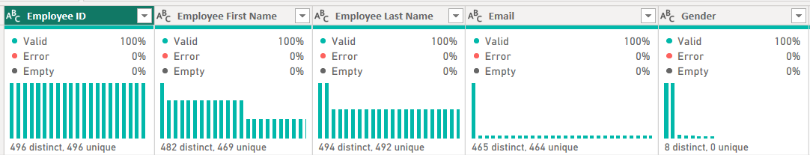
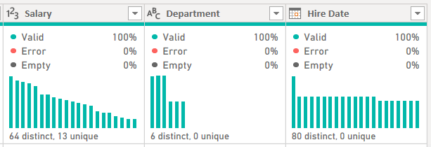
STEP 08 · VALIDATE
Column Quality Check, Post-Cleanup
Every column - Employee ID through Hire Date - now reads 100% Valid.

